Slide 1
Business Process Engineering
Notes:
1

Slide 2
Facilitator
KHALID HUSSAIN CHOHAN, Tamgha-i-Imtiaz (M)
  MBA (“HR” and “Finance & Investment”)
    NUST Institute of Management Sciences
  M.Sc. Mil Sciences & Management Specialization in Project Management
    NUST Institute of Management Sciences
  M.A (Economics)
    Peshawar University
  B.Sc. (Hons)- War Studies
    Balochistan University
  Contact:0335-8457692
  E-mail: chohankh@gmail.com

Slide 3
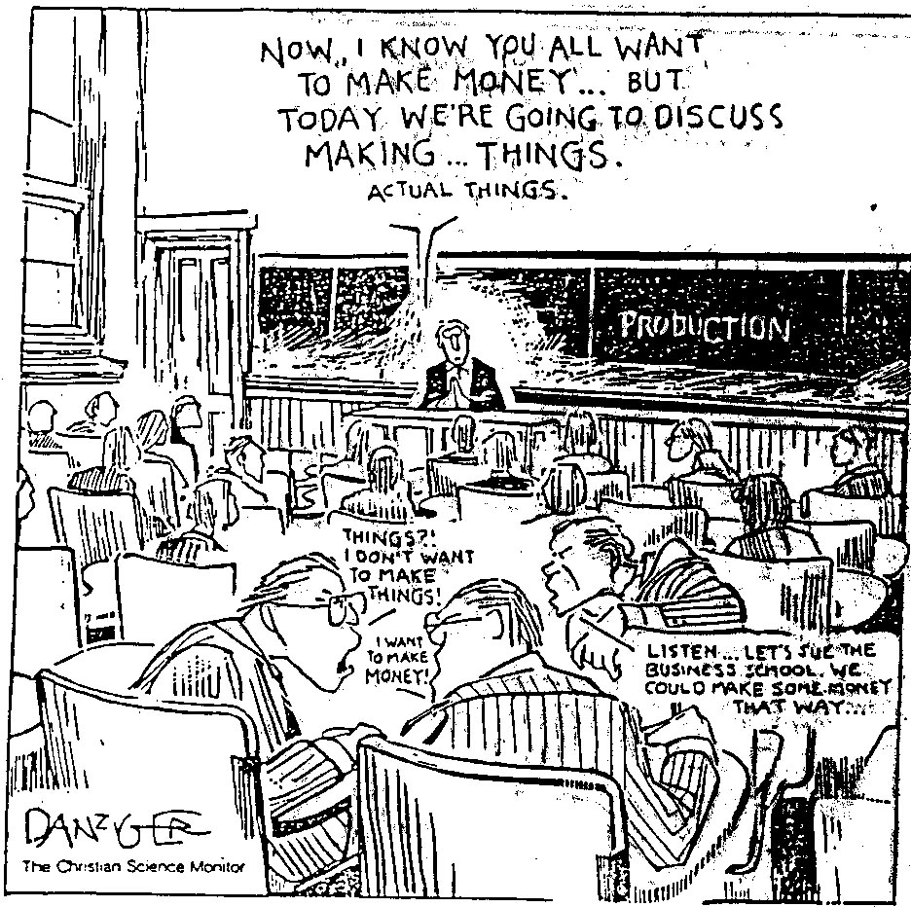

Slide 4
Business Process Engineering Introduction
How we manage our productive resources is critical to our productivity growth and competitiveness as a nation. Business Process Engineering isS the managing of these productive resources. It entails the design and control of systems responsible for the productive use of raw materials, human resources, equipment, and facilities in the development of a product or service.

Slide 5
Operations and Productivity
Notes:
1

Slide 6
What is Operations Management?
Production is the creation of goods and services
Operations (or Production) management is the management of activities that creates goods and services through the transformation of inputs into outputs
Notes:
6

Slide 7
Organizational Functions
Marketing - generates demand or at least takes the order for a product or service
Operations - creates the product
Finance/accounting - tracks how well the organization is doing, pays the bills, collects the money
Notes:
24

Slide 8
Summary Model of the OM Field
Marketplace
Corporate Strategy
Operations Strategy
Operations Management
People
Plants
Parts
Process
Planning and Control Systems

Slide 9
Process?
A process is a combination of orderly steps (activities) to convert defined inputs into defined outputs.
A good process maximizes the value-added content of its operations.
What is value? Anything that the customer will pay for.

Slide 10
Next Process is the Customer!
A process has customers, suppliers, and process managers!
TRANSFORMATION
PROCESS
SUPPLIER
INPUTS
OUTPUTS
CUSTOMER
Value added

Slide 11



Organizational Functions
Marketing
  Gets customers
Operations
  creates product or service
Finance/Accounting
  Obtains funds
  Tracks money
© 1995 Corel Corp.
Notes:
25

Slide 12
Functions - Airline
Airline
© 1984-1994 T/Maker Co.
Finance/
Marketing
Operations
Accounting
Flight
Ground
Facility
Catering
Operations
Support
Maintenance
Notes:
26

Slide 13
Functions - Bank
Commercial Bank
© 1984-1994 T/Maker Co.
Finance/
Marketing
Operations
Accounting
Teller
Check
Transactions
Security
Scheduling
Clearing
Processing
Notes:
27

Slide 14
Functions - Manufacturer
Manufacturing
Finance/
Marketing
Operations
Accounting
Production
Quality
Manufacturing
Purchasing
Control
Control
Notes:
28

Slide 15
Focus of Business Process Engineering
Technology/methods
Facilities/space utilization
Strategic issues
Response time
People/team development
Customer service
Quality
Cost reduction
Inventory reduction
Productivity improvement
Notes:
29

Slide 16
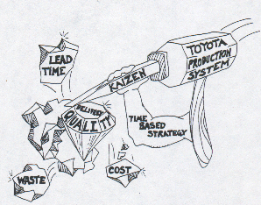
Customers View of Business Process Engineering
There are three issues a company must address.
  How to improve quality.
  How to reduce cost.
  How to ensure on time delivery without creating inventory.
Not improving in all three of these areas means a loss of competitiveness in today’s global markets.

Slide 17
Contributions from
Human Factors
Industrial Engineering
Management Science
Biological Science
Physical Sciences
Information Science
Notes:
13

Slide 18
Significant Events in Business Process Engineering
Division of labor (Smith, 1776)
Standardized parts (Whitney, 1800)
Scientific Management (Taylor, 1881)
Coordinated assembly line (Ford 1913)
Gantt charts (Gantt, 1916)
Quality control (Shewhart, 1924)
CPM/PERT (DuPont, 1957)
Flexible manufacturing systems (FMS)
Computer Integrated Manufacturing (CIM)
Notes:
14

Slide 19
What Operations Managers Do
Plan
Organize
Staff
Lead
Control
Improve
Notes:
17

